Slide 1
junkSort.AI
Juliette Lavoie, Isabella Nikolaidis, Julie Tseng AI for Social Good Summer Lab | McGill Innovation

Slide 2
Our aim
Use computer vision to aid the identification of compostable, recyclable, and waste materials
Notes:
For this project, I used rfMRI data from the Human Connectome Project, which is a collection of a large amount of MRI, behavioral data with pre-processing. More in a second.
Also used built-in functions from toolboxes such as the Signal Processing toolbox, for data smoothing and analysis.
Finally, a major component of the multi-node analysis phase of this investigation is a dimensionality reduction algorithm.

Slide 3
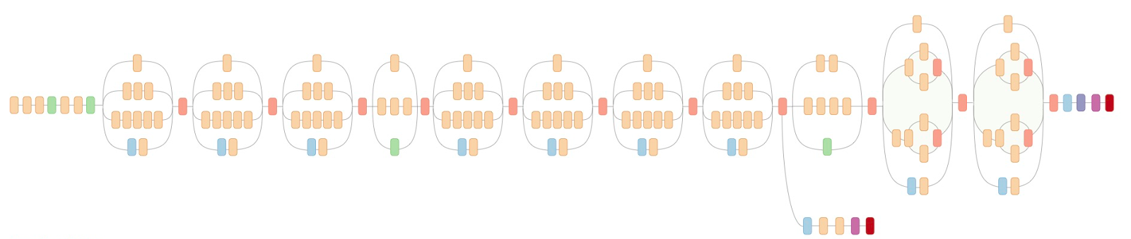

Process
Find pretrained model : Inception V3 network (based on )
Defined labels that go in each classes (Recyclable, Compost, Trash)
Retrained last layer for specific classes (TensorFlow for Poets)
Develop android app prototype
Notes:
Say the different step of training ( only paper and cardboard)

Slide 4
DEMO
1 L.J.P. van der Maaten and G.E. Hinton. Visualizing High-Dimensional Data Using t-SNE. Journal of Machine Learning Research 9(Nov):2579-2605, 2008
Notes:
This optimization problem means we’re choosing the coordinates to overall minimize the difference between the probability matrices.
Explain the physical analogy!

Slide 5
Potential improvements
Customizability
Different cities have different rules.
Refinement of last layer
Train on user feedback
Add more labels
Change pretrained network for the latest Inception version

